Slide 1
Level 6 Group 3 : Pitch Presentation
Presented on 11/10/2017
River Chick
Michael Curtis
Ryan Manthorp
Ogheneochuko Ideh

Slide 2
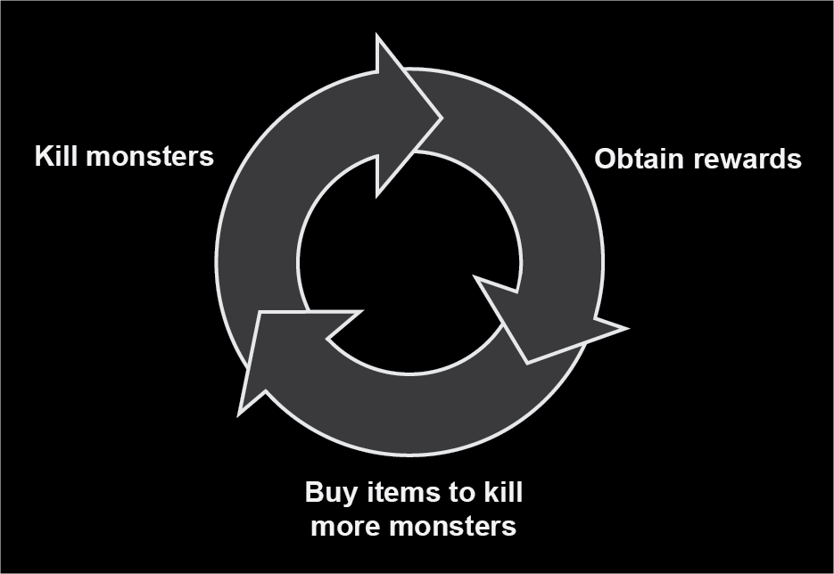
What is our brief?
Player retention is a key skill for game designers.
This is achieved through compulsion loops.
Our brief is to harness and showcase the ability of compulsion loops.
Figure 1

Slide 3
Our task
Create an experience showcasing one or more compulsion loops.
Effectively encourage player retention.
The experience must feature identifiable:
Triggers
Player actions
Variable rewards
A suitable player investment. (Eyal,2014)

Slide 4
Restrictions
No embargo on themes and motifs.
The game must be targeted towards a casual demographic.
UI must be clear & easy to navigate.
Clear affordances.
Suitable to be player able over weeks and even months.

Slide 5
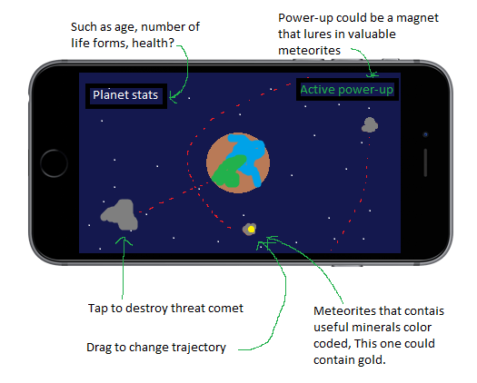
Planetary V-PET SUMULATOR CONCEPT
Figure 2

Slide 6

At The beginning
Start with a small rock
Tap that rock to make it yours

Slide 7
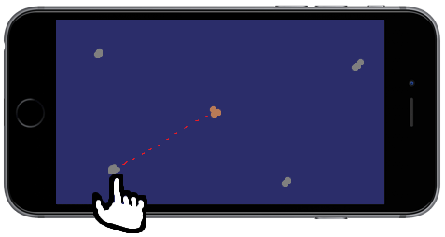
Creating the first planet
Rocks will drift in and out of frame
Select a rock and drag to change trajectory
This will build mass and the planet will grow

Slide 8
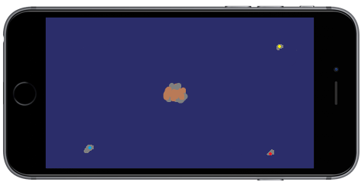
Adding minerals
Drag them the same way as standard rocks
Colour coded to determine the mineral
Also add mass to the planet

Slide 9
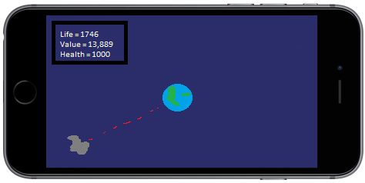
Maintenance of the planet
Soon after adding minerals the planet will have a set of stats
Also larger rocks with no minerals can harm the planet
Tap to destroy them into smaller rocks and tap to destroy them again
Or add the smaller ones as mass

Slide 10
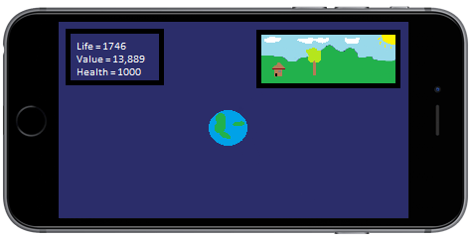
A closer look
Tapping on the planet will open a live window of a close up of the surface
This window will visually represent how the planet it doing other than just the stats
Main things it will show is lifeform and wealth

Slide 11
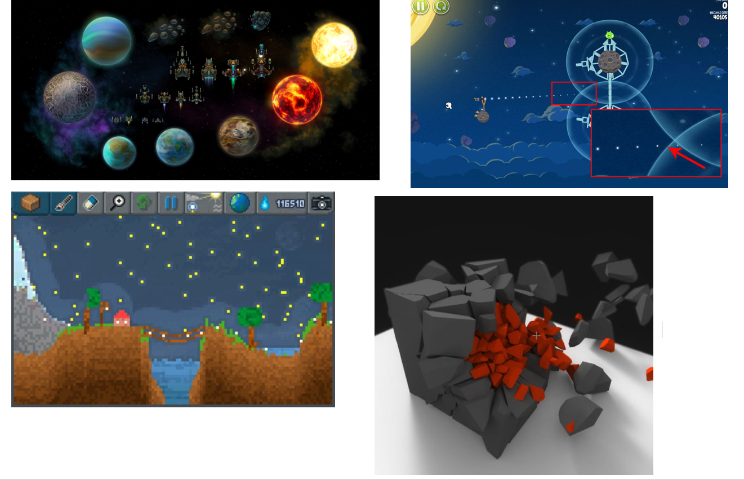
Early concept work and Prototype
Include concept art and video footage.

Slide 12
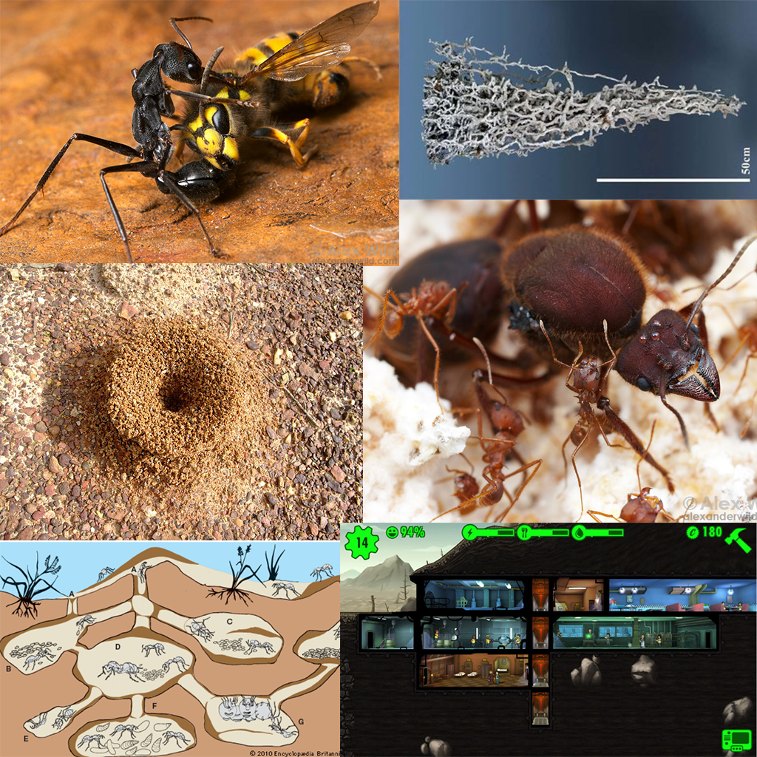
Managerial colony game concept
Figure 3

Slide 13
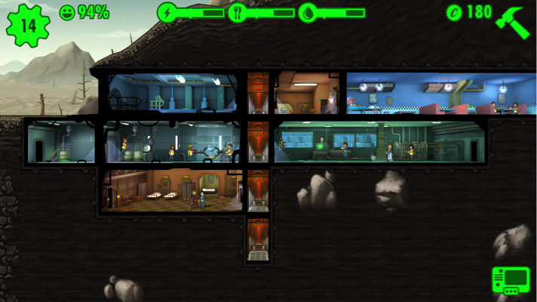
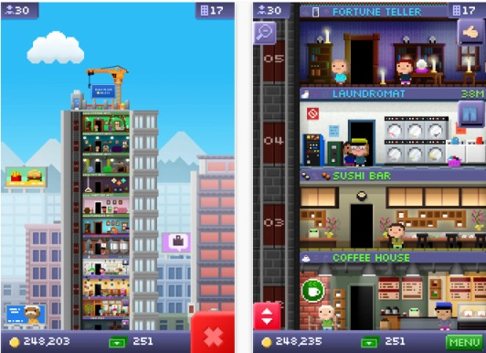
Research
Core Loops and Compulsion Loops in Managerial Idle Games
Notes:
Discuss the key features of managerial idle games, especially the compulsion loops (especially fun pain). With special relation to Fallout Shelter and Tiny Towers.

Slide 14
Core Loop
Trigger: Previous tasks complete (Notification)
Action: Select completed task prompts
Reward: In game currencies/resources
Investment: Spend currencies/resources on setting new tasks to be carried out
Notes:
Briefly go over the key elements of a compulsion loop and explain how managerial idle games tend to accomplish this. With special reference to how the different elements are presented in Fallout Shelter, Tiny Towers and the pitched game.

Slide 15
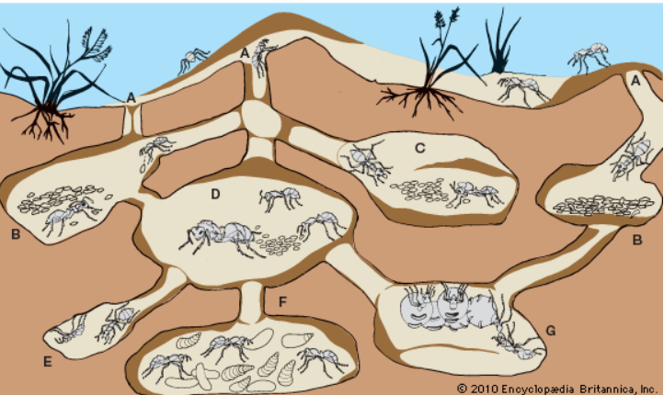
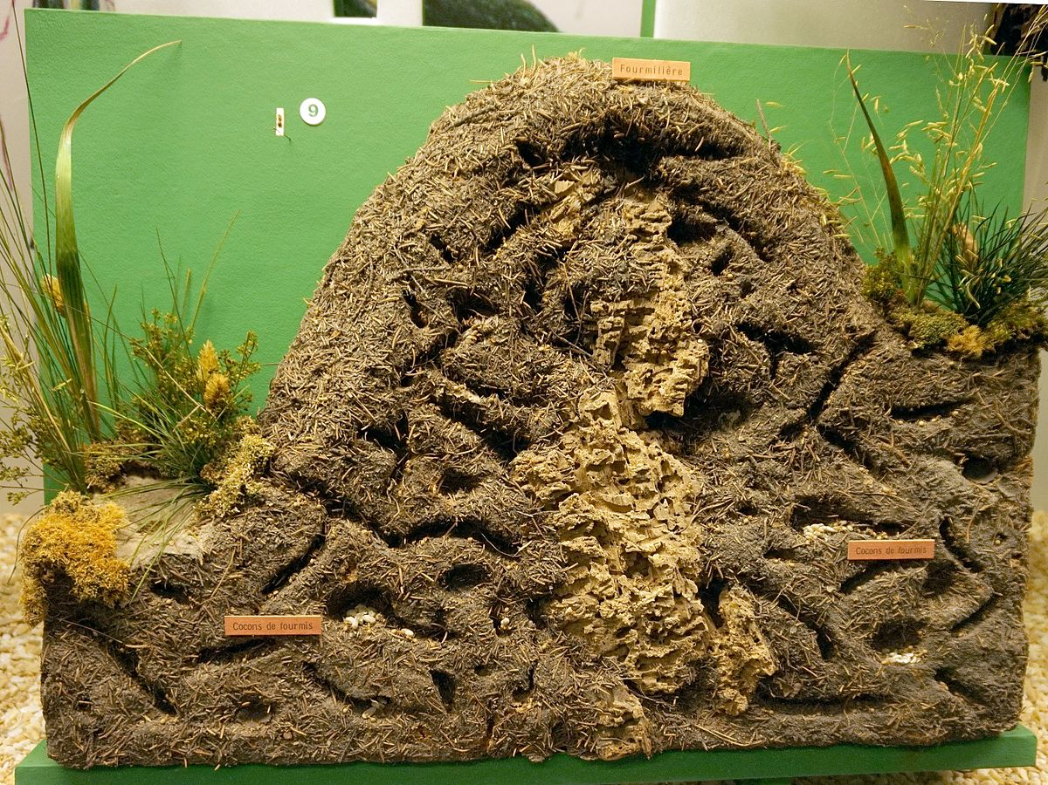
Theme
Ant Hives
Notes:
Explain the theme of the game. Hives can be built with modular rooms as in Fallout Shelter to allow for ever expanding play, ants have drone like responsibilities that fit in well with the game, the knowledge of ants building hives is well known enough that powerful affordances can be created.

Slide 16
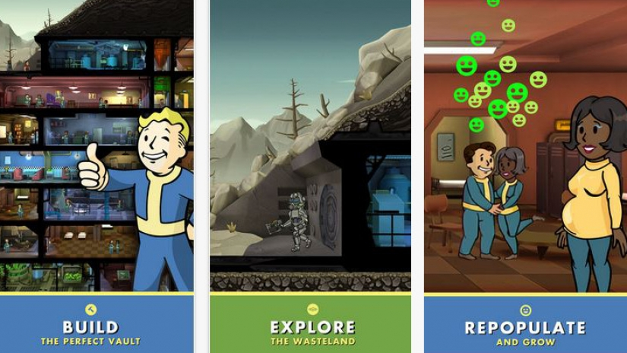
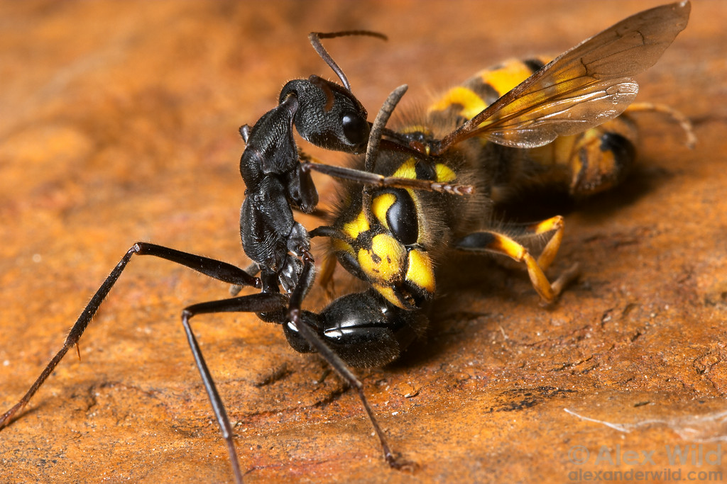
Additional Loop
Additional Management based compulsion loops
Notes:
Explain how both Tiny Towers (and especially) Fallout Shelter have additional loops to draw players in (Shelter has breeding and exploring mechanics entirely based around management (Real time and idle respectively)). Then explain how at least one additional loop will reinforce the core loop and what that loop would be. (Relate to design document)

Slide 17
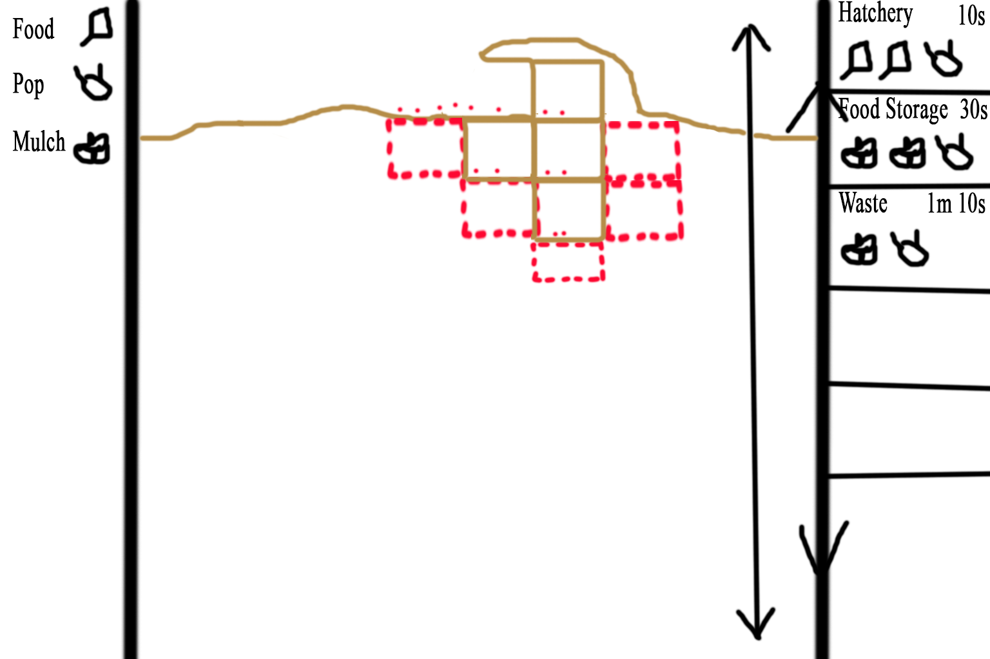
Game Screen Mock Up
Notes:
Talk through the UI and how players are able to interact with the screen. Middle and right panels can be scrolled up and down. Left Panel displays current resources and possibly other statistics about the hive. Right panel shows tasks that can be started (Rooms that can be constructed) with the resource cost and the amount of real time the task will take to complete, if the player selects a room task that they can afford the red outlines appear in the middle panel showing where the room can be constructed, the player must select one of the outlines for the task to begin. The Middle panel shows the hive with the ant population performing animations according to their current task and all the different rooms that have been constructed. Players will be shown tasks that are finished and can select them to receive the rewards. Finished rooms that produce a resource must be worked by the population, by selecting a room that does not have a completed task will disable the room so that the population in it will return to the resource pool, a disabled room can be enabled again by selecting it if there are enough ants to begin working it again. Working rooms periodically finish constructing resources and must be selected by the player to receive the reward and get the room working again.

Slide 18
Early concept work and Prototype
Include concept art and video footage.

Slide 19
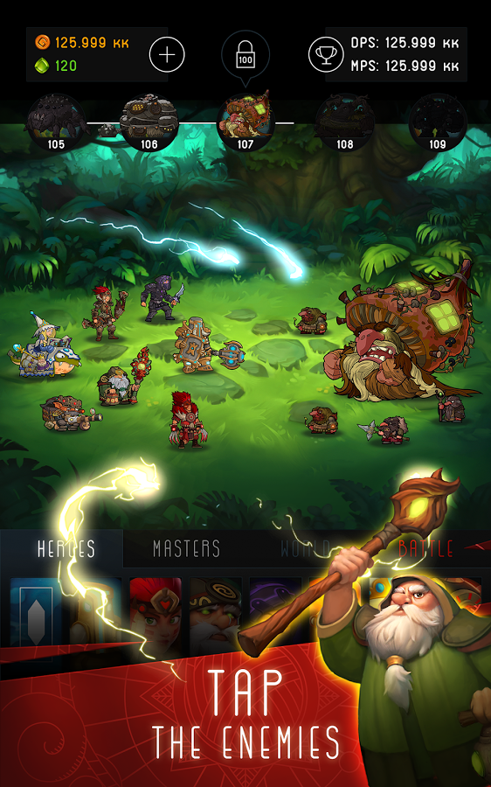
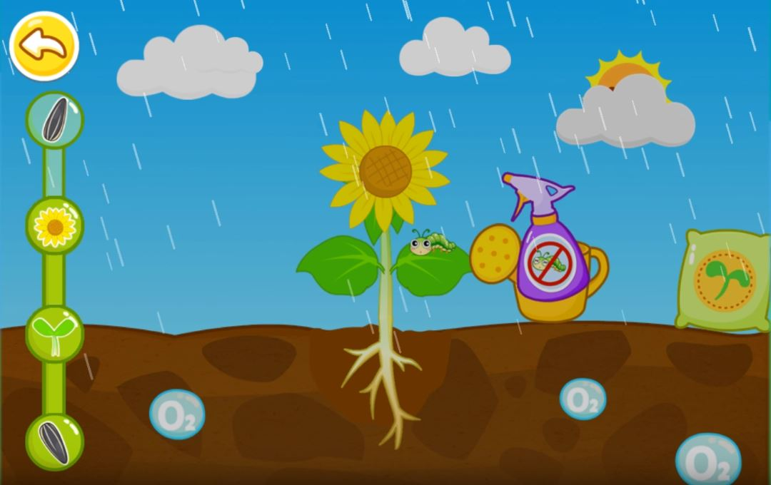
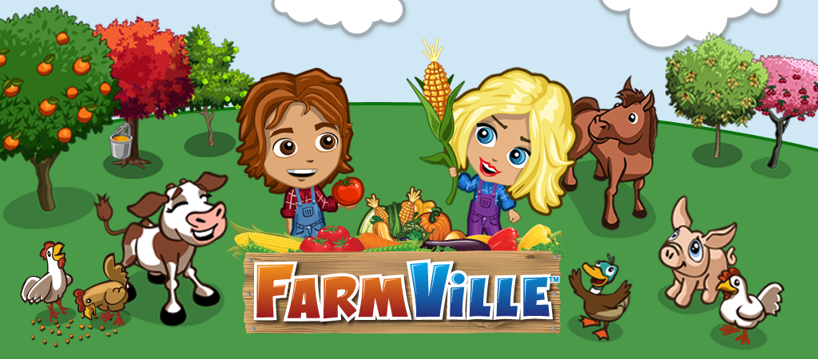
Plant Clicker game
Tapping
Idle game
Relaxing / soothing
(Sounds and visually)
Figure 4

Slide 20
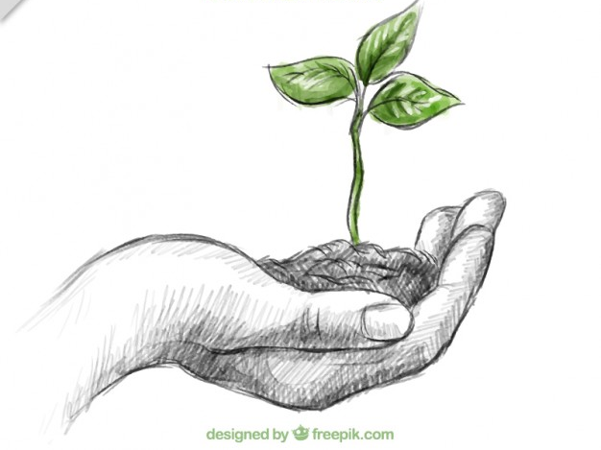
To keep them coming
Notifications for everything in game
(e.g. Garden is full of leaves)
If anything happens to your plant
(E.g. Leaf falls off from heavy winds)
The way Farmville makes people come back
The nurturing and maintaining of your own small environment
Emotional connection
Weather updates / changes
Possibly damage plant

Slide 21
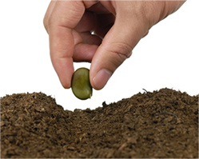
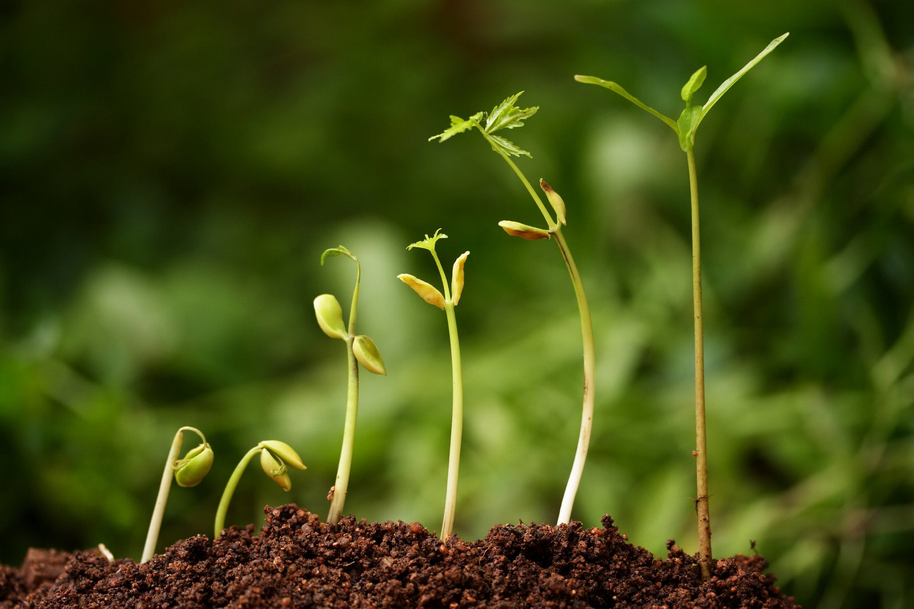
From seed to plant
Start as a seed (Of your choice)
Tap to water your plant
Blossom into a flower
Keep your “garden” clean
Not in real time
Player interacting rewards in-game currency

Slide 22

Players possibilities and options
Different upgrade paths to choose from
Example of possible upgrades:
The sun
The players tap
The chances of it raining (out of game)
Sun – more idle
Players tap – more active
Chances of it raining – They are unsure

Slide 23



Keeping your garden clean
There are a few things:
Leaf blower – Loose / fallen objects
Costs a very small amount of in-game currency
(Not small enough for constant use)
Tapping – Removing overgrown scenery
Gives in-game currency

Slide 24
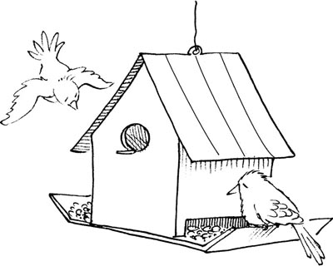
Birdhouse
Buying a birdhouse with in-game currency
Pros:
Receive lots of in-game currency whilst away
Gets rid of worms and other insects
Peaceful birds singing
Birds flying around the screen
Cons:
Costs in-game currency to refill
Plant may be damaged and need to re-grow

Slide 25
Thank you for your time, questions?

Slide 26
bibliography
Figure one:
Mark A Hart . (2013). Developing the Conditions for Better Compulsion Loops in New Product Development. Available: http://oplaunch.com/blog/tag/core-compulsion-loop/. Last accessed 09/10/2017.
Eyal, N. and Hoover, R. (n.d.). Hooked.

